Slide 1
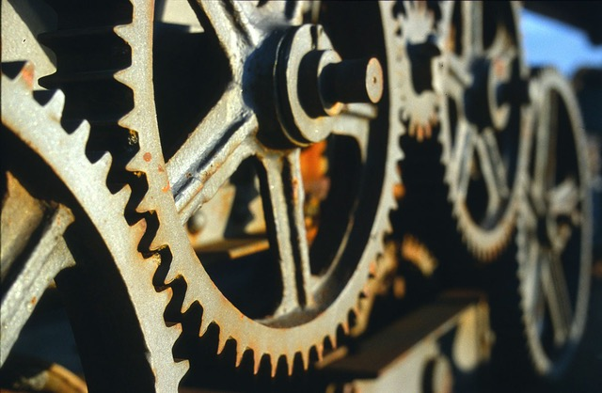
Notes:
Aim is just to introduce them to the lab staff and get them comfortable talking in the space
Why are they here? What brought them here?
What is digital humanities for each of us? What was our own particular path into it
welcome to ask me or us questions as we go
TODO: Look with an eye to the summer retrospective stuff

Slide 2
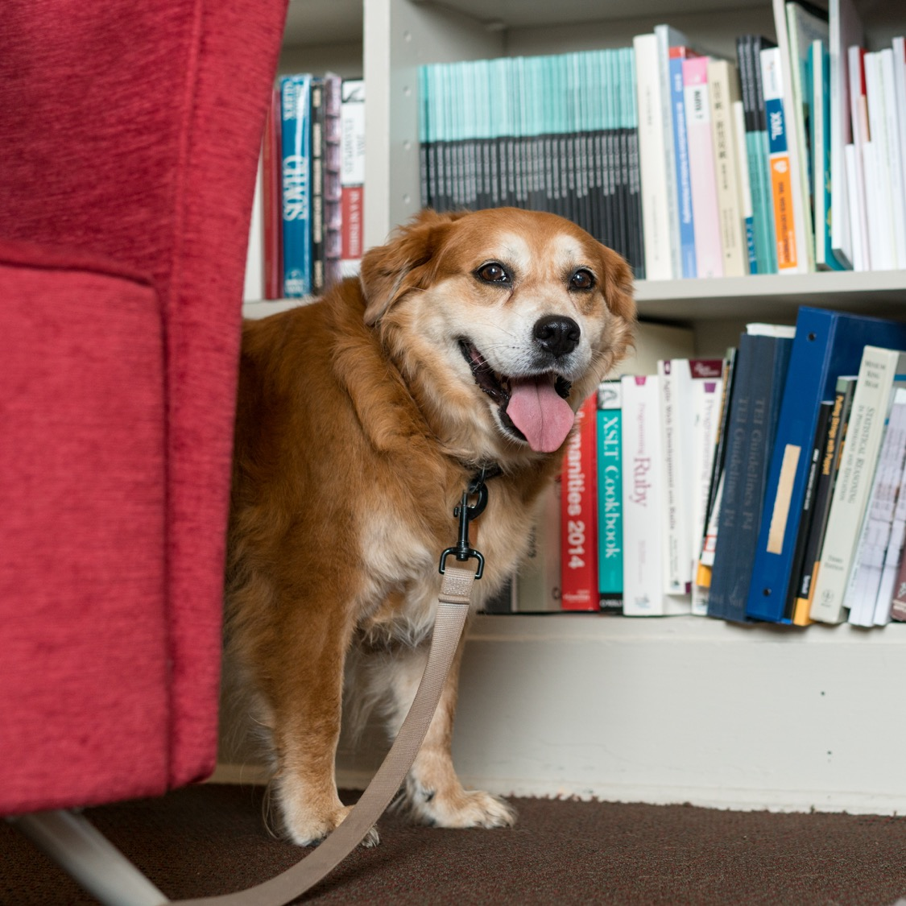
Introductions
Name
Department / what you do
Something else about you

Slide 3
Spaces and Expectations
We'll be in 313 for the fall. Can re-evaluate as needed, and hybrid option is available.
Make sure you have good Slack notifications set and engage if you can.
Up to date info here - praxis.scholarslab.org/curriculum/
Mostly set, but things get shifted around
If something is TBD but you need to know reach out
10 hours a week / 3 hours in session together
Mondays from 10-12 and Wednesdays from 10-11
Note on working together
Accountable to each other
First and foremost, kindness and generosity
Notes:
Much of the ten hours is going to be taken up with

Slide 4
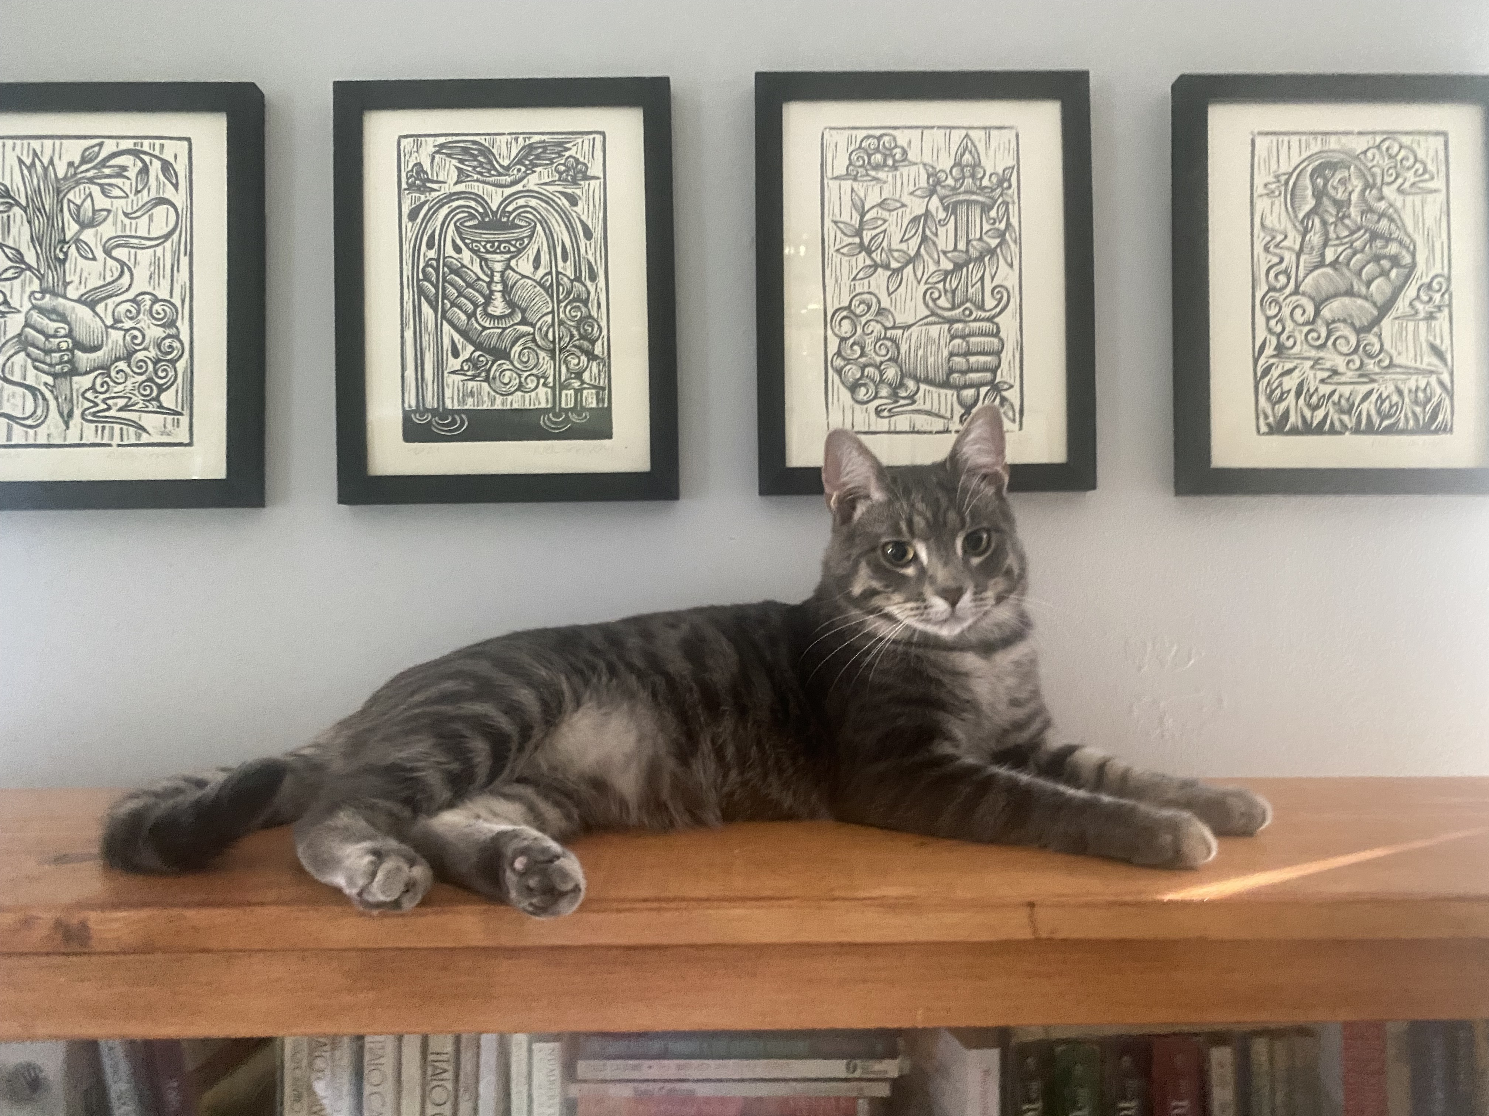
Care Policy
The world is a mess – take care of yourself, yours, and each other.
It’s fine if you have to miss a session.
As a courtesy, let us know if you can’t make it.
We’re accountable to each other, though and it’s important to show up as we can, in every sense.
We can address things if presence becomes a
problem, but lead with care and kindness first.

Slide 5
Asking for Help
Work with each other
Work with staff
We have a team-oriented approach, and we hope you will as well
Means we might have to shuffle who will help you if you reach out
Agendas help make sure you get the help you need
That is all to say – when reaching out please let us know what you need help on. That will ensure that we get the right person in the room.

Slide 6
Financial Logistics
If you get paid, let us know
If you think you should get paid but haven't, let us know
If you so much as sense an ill wind about finances, let us know
Better to be redundant than to be delayed
A note on the GSAS portions of your fellowship
Let us know privately after session?
Notes:
We don't hear when things go wrong. We also don't hear when they go right. Let us know about everything.

Slide 7
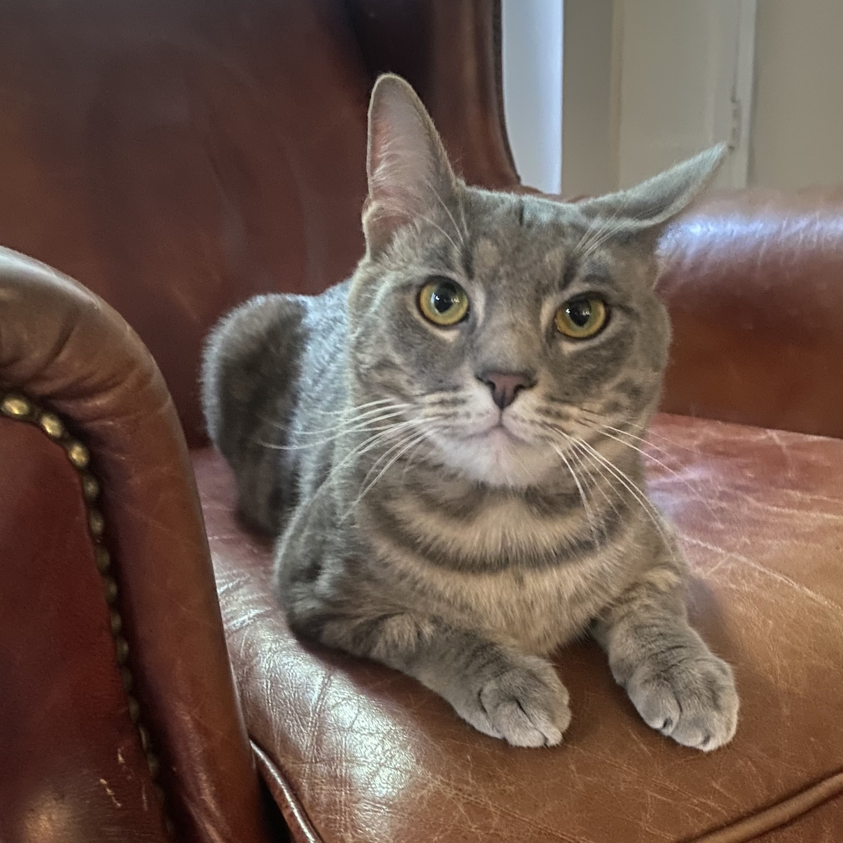
phdplus.virginia.edu
Notes:
Explain program and pass out handbills

Slide 8
Other Scheduling Things
Be thinking about ways to maintain a community
Friday Sept. 2nd at Kardinal Hall
DH Fellows colloquium series – dates forthcoming
Will let you know about other relevant events and put them on the curriculum page
Come to our events
Notes:
We don't hear when things go wrong. We also don't hear when they go right. Let us know about everything.

Slide 9
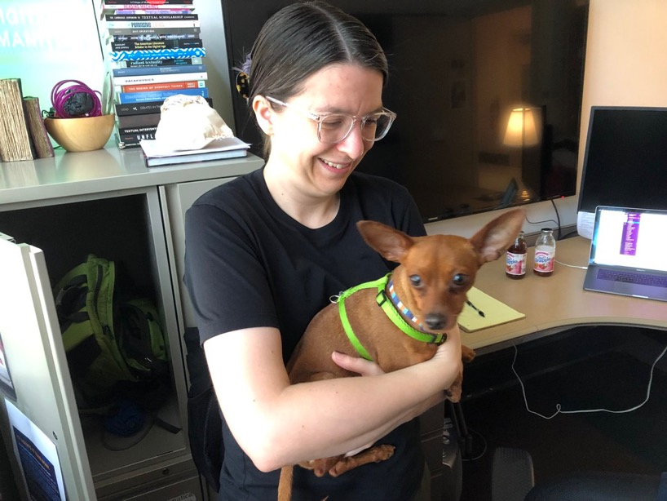
Code Lab and Design Lab
Parallel technical training track
Not to separate hacking from yacking, but to make sure both get time
Once per week
Allows us to go further
Code Lab in the fall
Design Lab in the Spring
More in following slides!

Slide 10
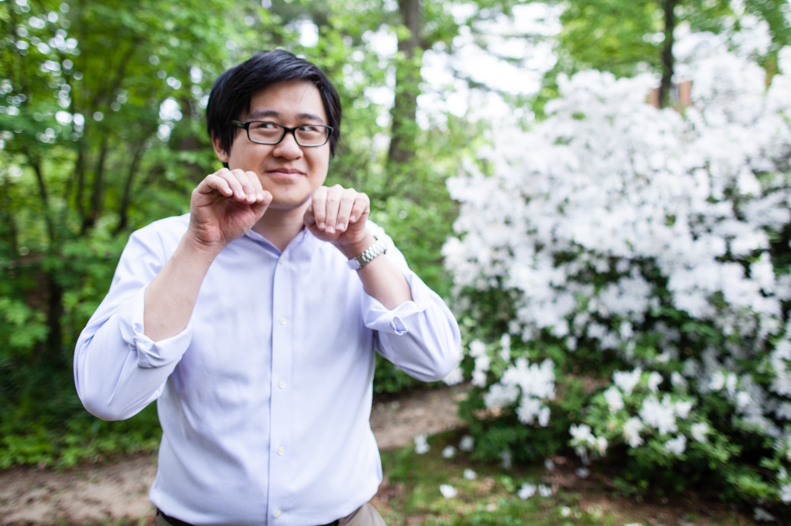
The World According to Shane (Head Shots)
Shane is our awesome photographer
He can do headshots for you
Share one if you already have one.

Slide 11
Blogging
Expected to blog semi-regularly
Aim for two each semester; feel free to do more.
For most of you, this will be unpleasant. That's ok!
A blog post can be anything you want it to be!
Check scholarslab.org for ideas
bit.ly/Slab-Blog-Docs
Start drafting now, and we'll work on a time for helping you
Caveat about the internet/cesspool

Slide 12
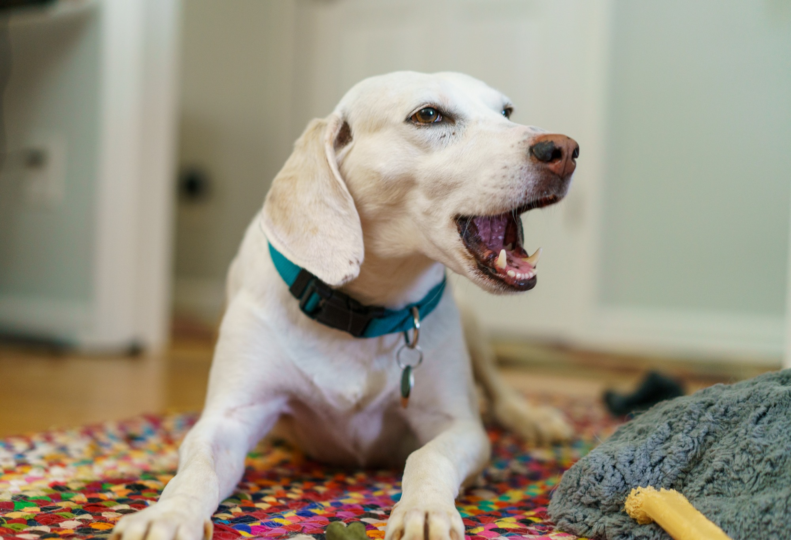

Slide 13
Slack
All invited to the Scholars' Lab slack
Feel free to make your own channels, but also good to be public
Anything we post you're welcome to chime in on
DH Slack - tinyurl.com/DHslack

Slide 14
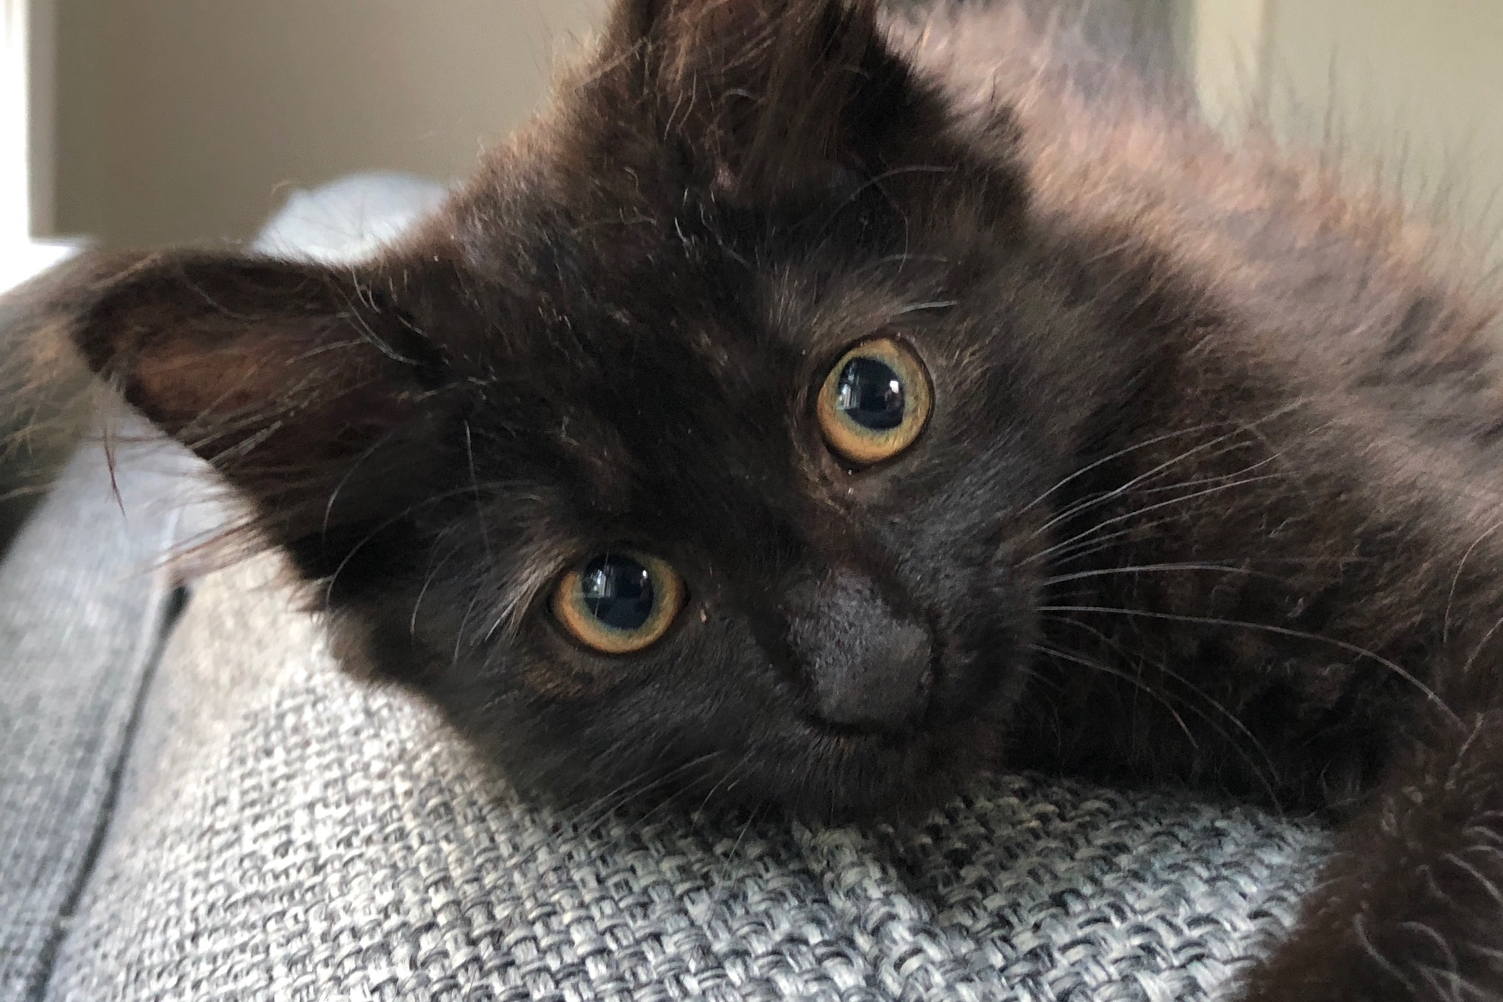

Slide 15
Models we've worked with
Year-long (or more) project where we give the thing, more or less
Prism – prism.scholarslab.org
Ivanhoe – ivanhoe.scholarslab.org
Pros
Intervention often feels more realized
Deep on a single technology
Predictable tech stack (easy to plan)
Cons
Students less invested
Students less empowered
Deep on a single technology
Notes:
The idea behind this is really that you're going to be doing stuff at the same time that you're thinking. Talking at the same time that you're working. Solo but mostly in various iterations of together.

Slide 16
Models we've worked with
Year-long project where we have the students generate the thing
Clockwork – clockwork.scholarslab.org
Dash-Amerikan - dashamerikan.scholarslab.org
UVA Reveal - reveal.scholarslab.org
Pros
Students are empowered
Some students are invested (the talkers)
Deep on a single technology
Cons
Difficult to support
Intervention less realized
Deep on a single technology
Most students still not invested

Slide 17
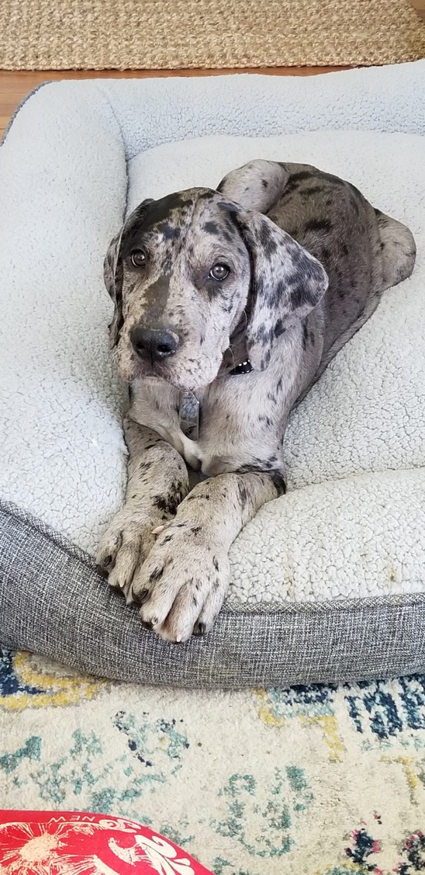
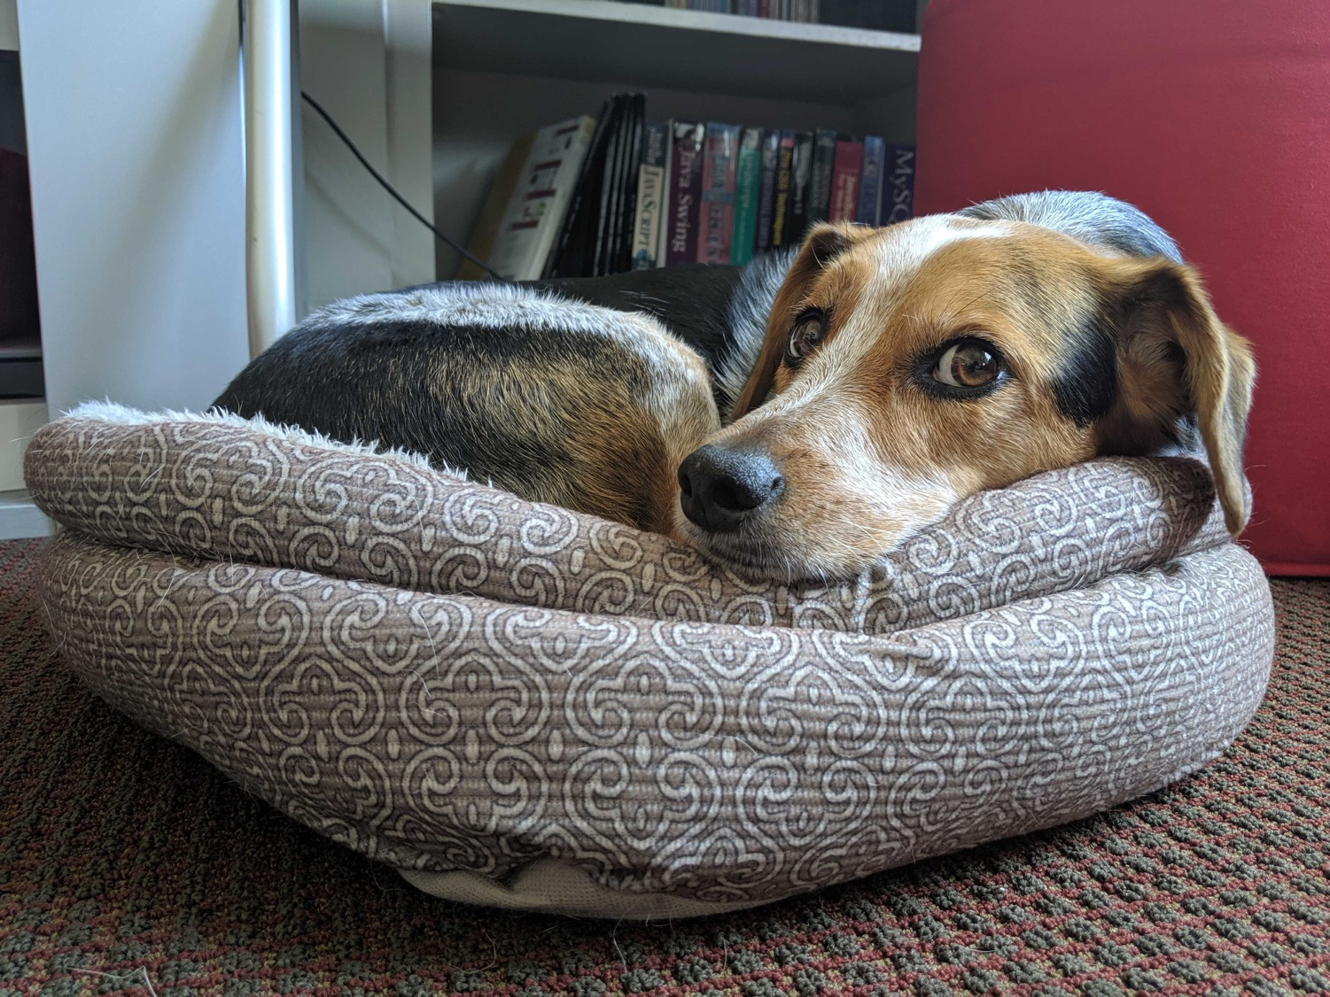

Slide 18
Now
Portfolio vs Project
A series of outcomes that better reflect the breadth of DH work
Some group activities, some individual
Fall
Communities of DH – group charter
Pedagogy and DH – DH workshop and teaching statement
Codelab – technical practice
Spring
Research / Infrastructure and DH – Personal project Proposal and workshopping
Hackathon

Slide 19
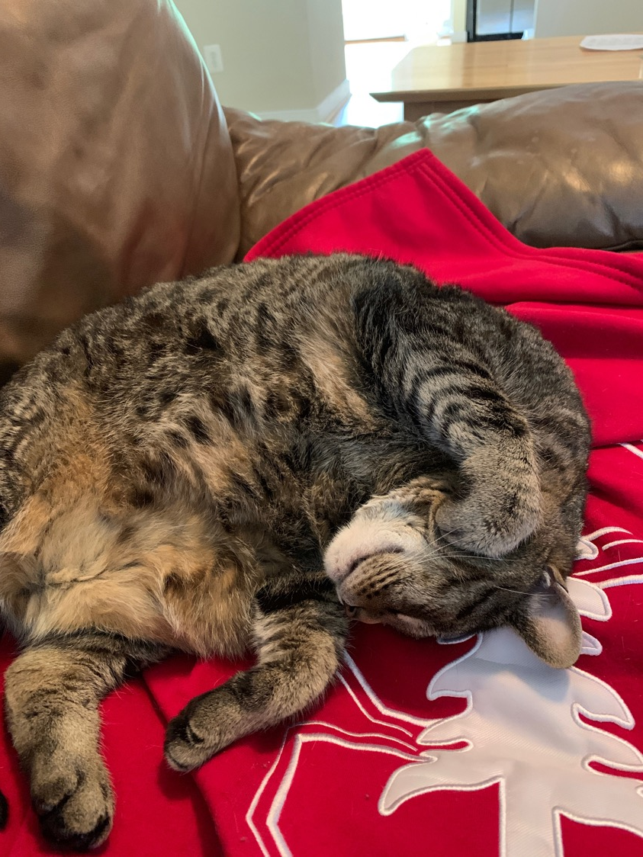
Fall pt. 1 DH Communities – Charter
What constitutes a community in DH? How will we design one together? How do DHers articulate these practices in public?
You will design a charter
Group-authored statement
Values
Goals
Feelings
Ronda will share more
Due September 26th

Slide 20
Fall pt. 2 - Pedagogy DH Workshop and Teaching Statement
What does teaching and learning look like in Digital Humanities? What are our own pedagogies, and how can we inflect those in DH?
Two assignments
Lightweight workshops, piloted together
Teaching to learn
Opportunities to share them
Teaching statements with a DH focus
Due November 28th

Slide 21
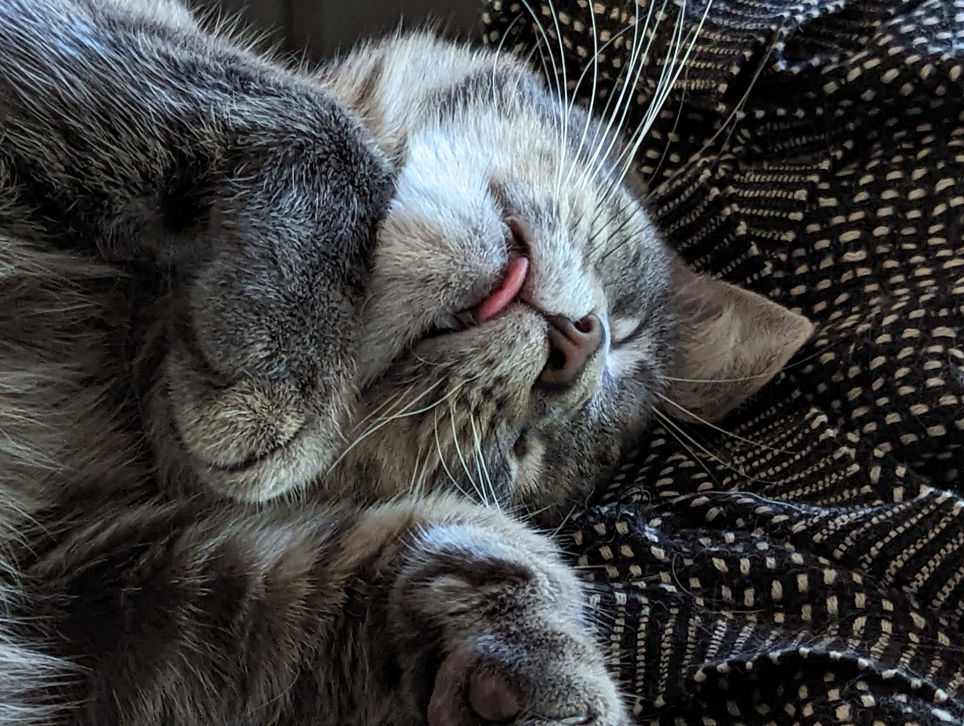
Fall pt 3 – Code Lab
CodeLab is a semester-long introduction to the foundations programming and computational thinking for Digital Humanities.
You will gain experience using a variety of technologies (Python, git/github) relevant to technical work in DH and exercise these new skills with some focused activities relevant to DH work.
Variety of outcomes throughout the semester
Mic to Shane

Slide 22
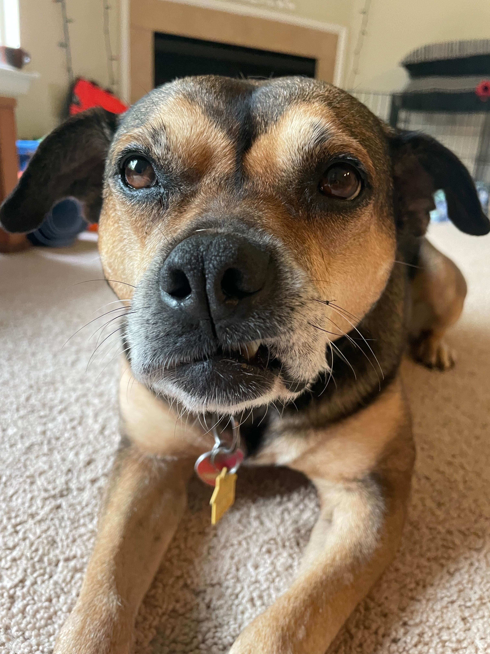
Spring pt. 1 – DH Research / Infrastructure
What do we mean when we call something a digital project, and how do we define them with an ethos that is meaningful to us? How do infrastructure and administration in the field intersect with DH research, enabling or inhibiting it?
Personal project proposals that we workshop together
Also a chance to make a personal
proposal for going further

Slide 24
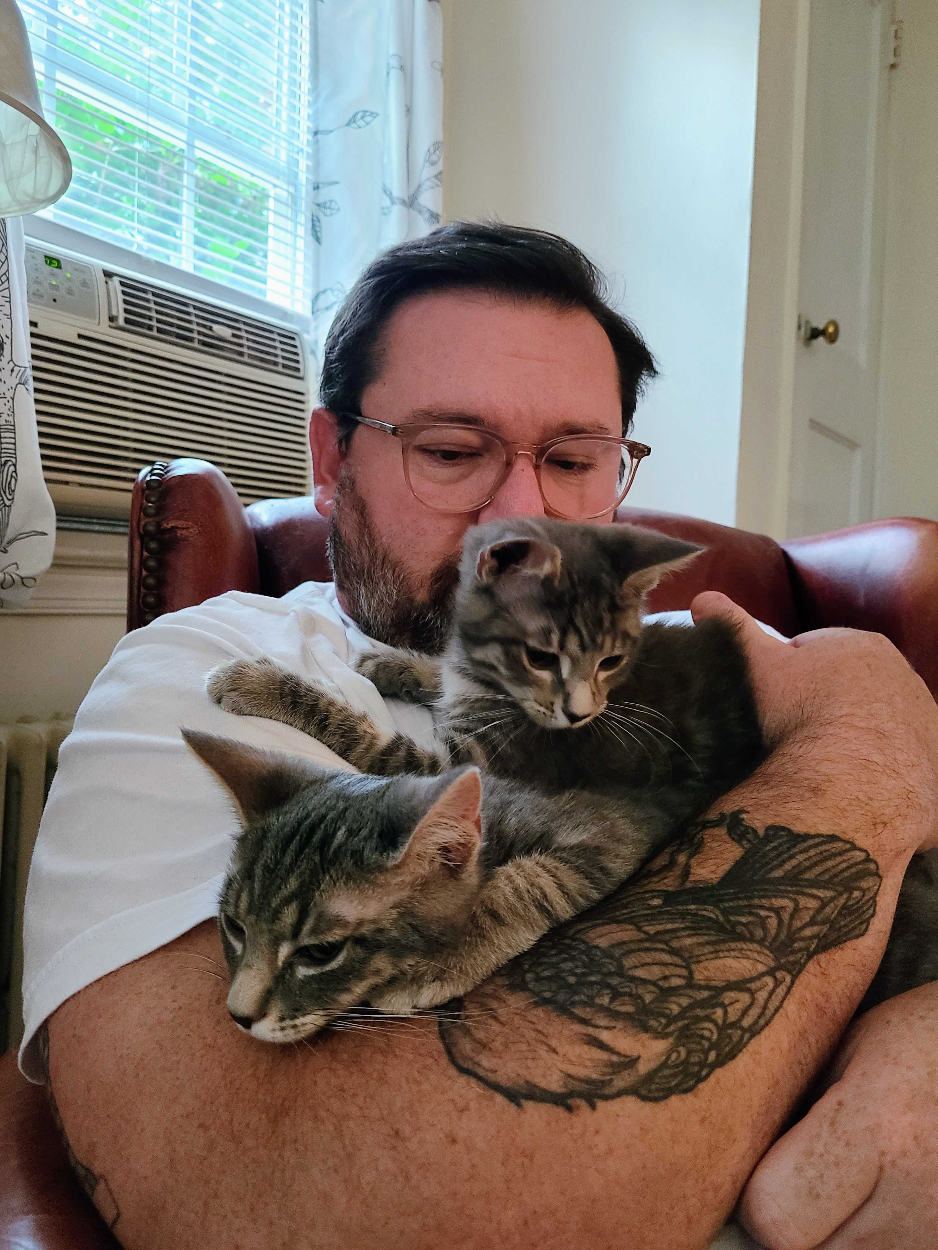
Spring pt 2 – Design Lab
DesignLab is a parallel 10-week primer on critical approaches to design for Digital Humanities work, that includes conceptual and application work in the following areas:
HTML, CSS, JavaScript;
Information architecture/organization
Graphic/Visual design elements and concepts
Accessibility + Usability
Scoping/Strategizing approaches for design projects;
Mic to Jeremy

Slide 25
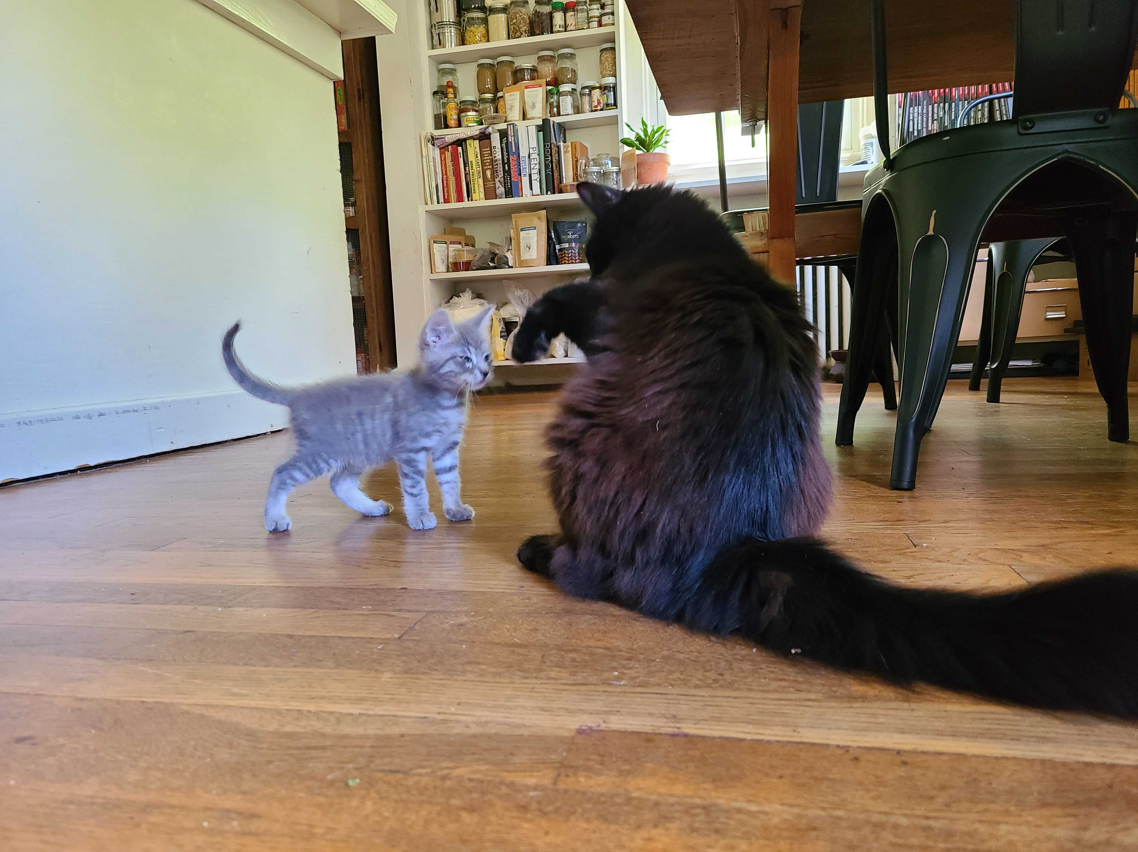
Spring pt. 3 – Hackathon
How can we put all this together? What does concentrated team work on a technical project in DH look like?
Concentrated space for collaboration
Mic to Shane

Slide 26
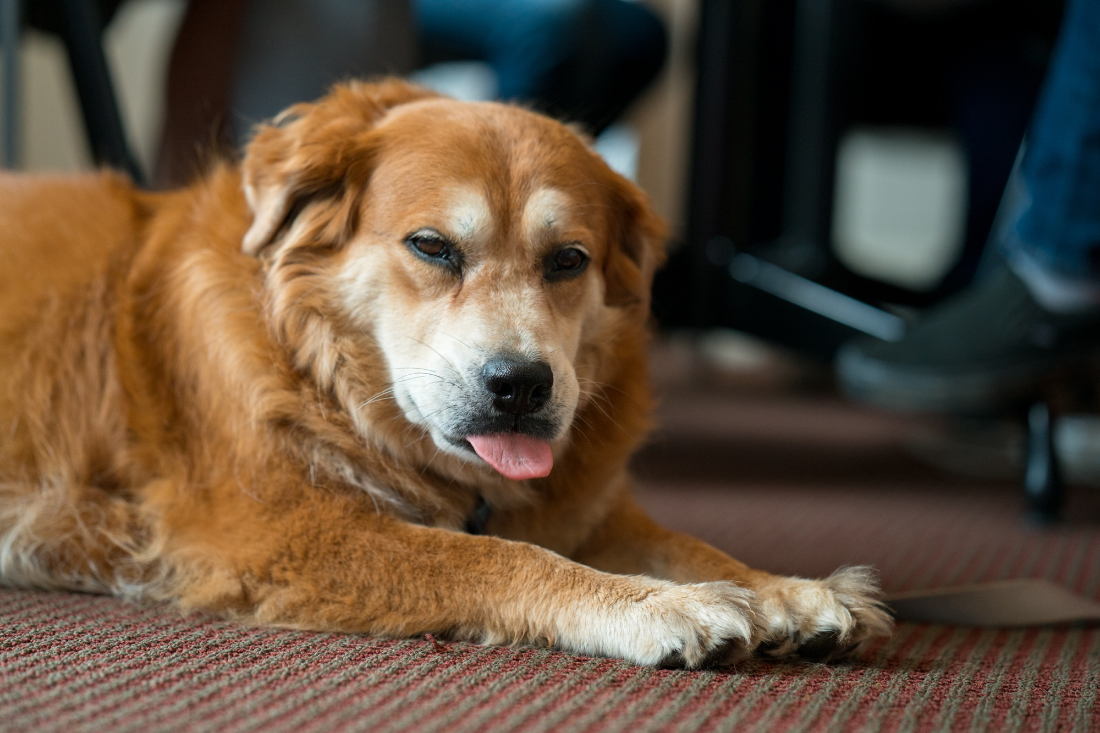

Slide 27
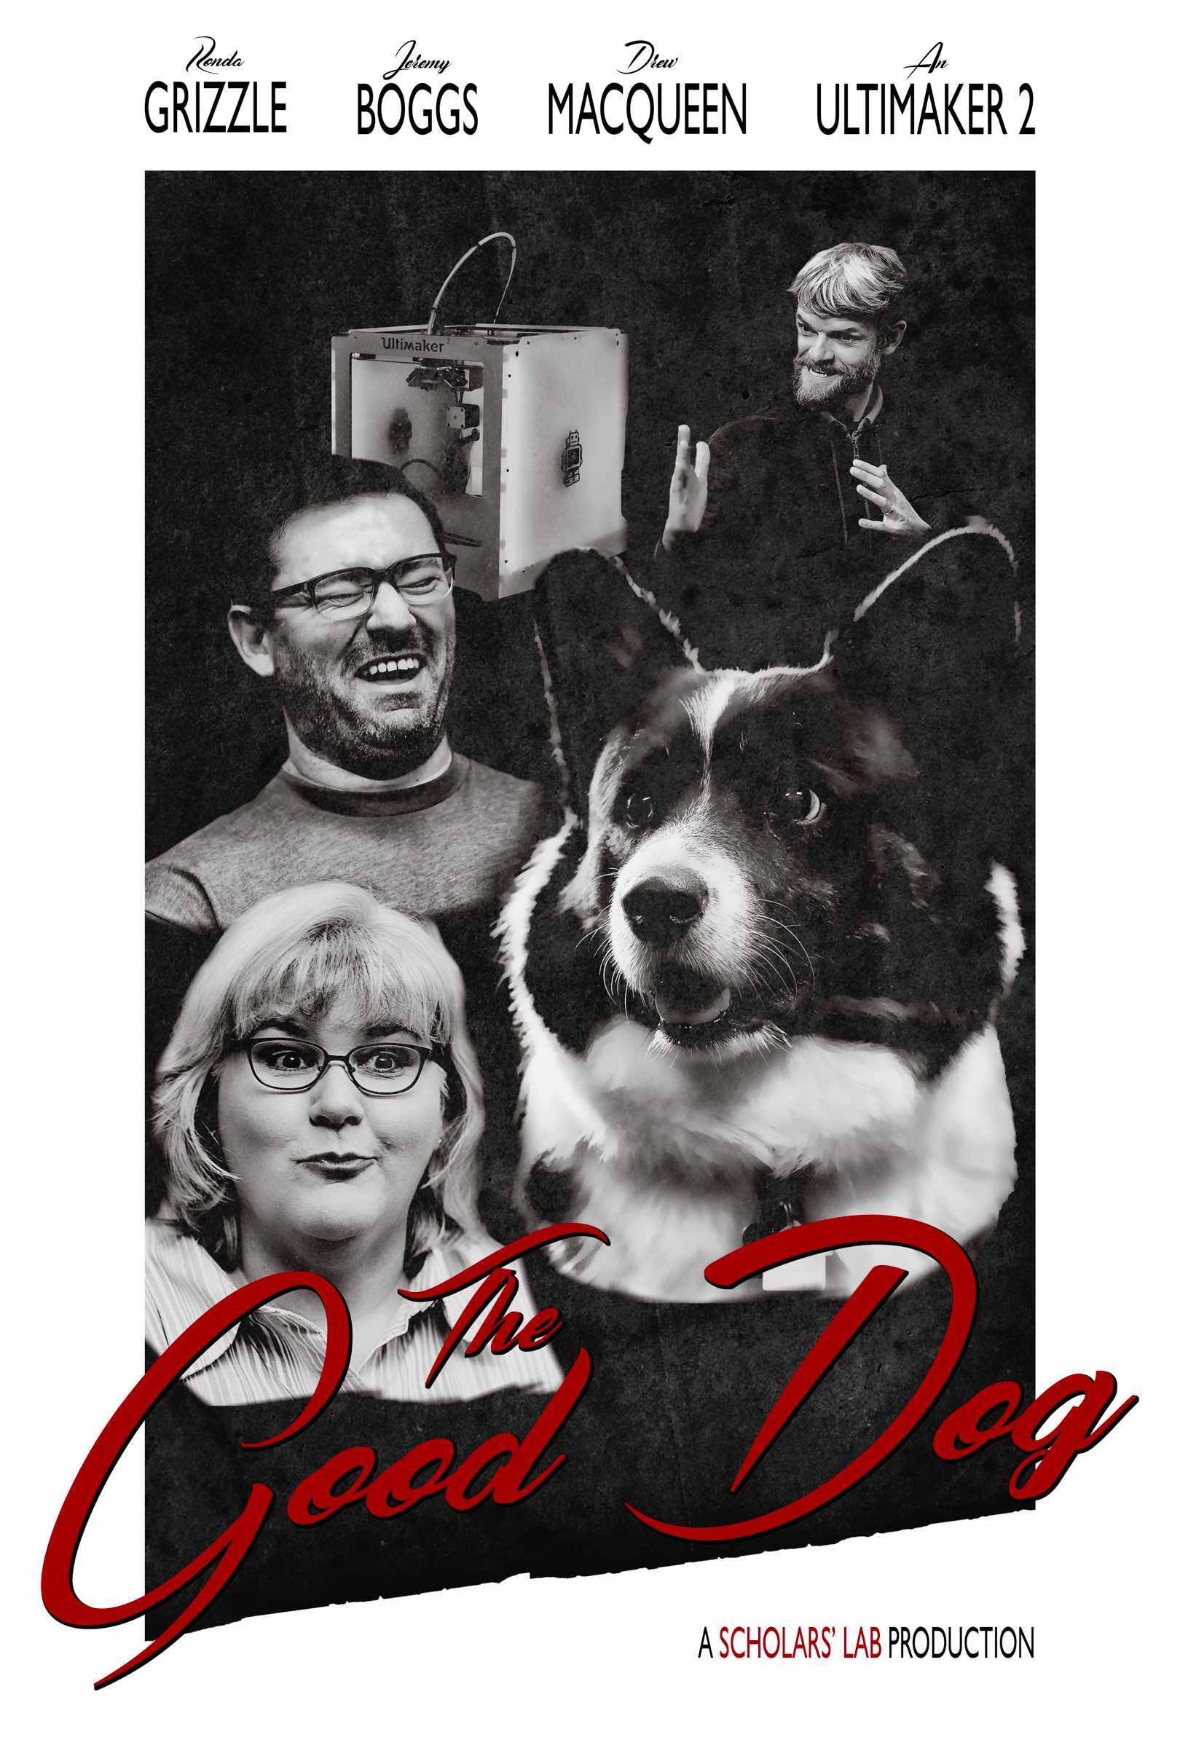
Initial Things
Meet with Shane 1:1 for tech set up
Readings, etc. on the curriculum page
Be present as you’re able
Check in about finances
Next meeting starts our regular MW rotation
September 2nd at Kardinal hall

Slide 28
Questions and First Discussions
Notes:
Why are you here?
What do you want out of life? Who are you really?
What are some general reactions to the documents I circulated in advance

